Slide 1
Outline
Introduction
Background
Distributed Database Design
Database Integration
Schema Matching
Schema Mapping
Semantic Data Control
Distributed Query Processing
Multimedia Query Processing
Distributed Transaction Management
Data Replication
Parallel Database Systems
Distributed Object DBMS
Peer-to-Peer Data Management
Web Data Management
Current Issues

Slide 2
Problem Definition
Given existing databases with their Local Conceptual Schemas (LCSs), how to integrate the LCSs into a Global Conceptual Schema (GCS)
GCS is also called mediated schema
Bottom-up design process

Slide 3
Integration Alternatives
Physical integration
Source databases integrated and the integrated database is materialized
Data warehouses
Logical integration
Global conceptual schema is virtual and not materialized
Enterprise Information Integration (EII)

Slide 4
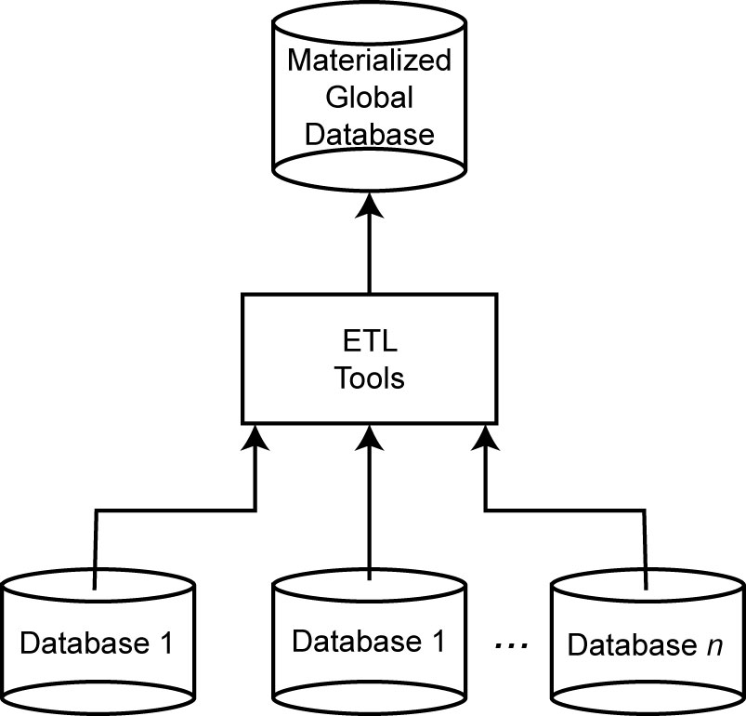
Data Warehouse Approach

Slide 5
Bottom-up Design
GCS (also called mediated schema) is defined first
Map LCSs to this schema
As in data warehouses
GCS is defined as an integration of parts of LCSs
Generate GCS and map LCSs to this GCS

Slide 6
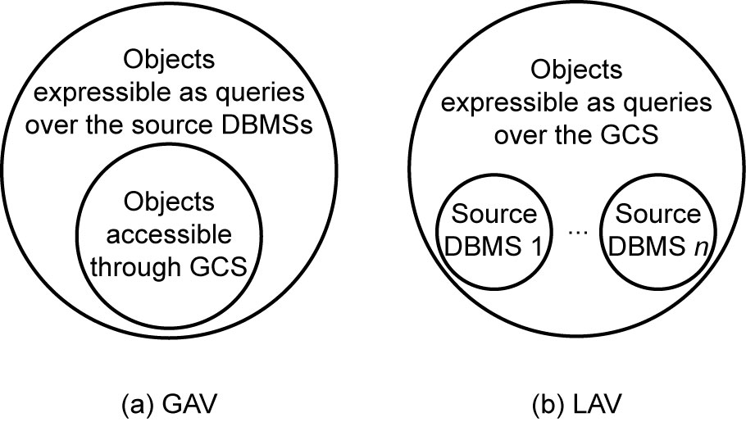
GCS/LCS Relationship
Local-as-view
The GCS definition is assumed to exist, and each LCS is treated as a view definition over it
Global-as-view
The GCS is defined as a set of views over the LCSs

Slide 7
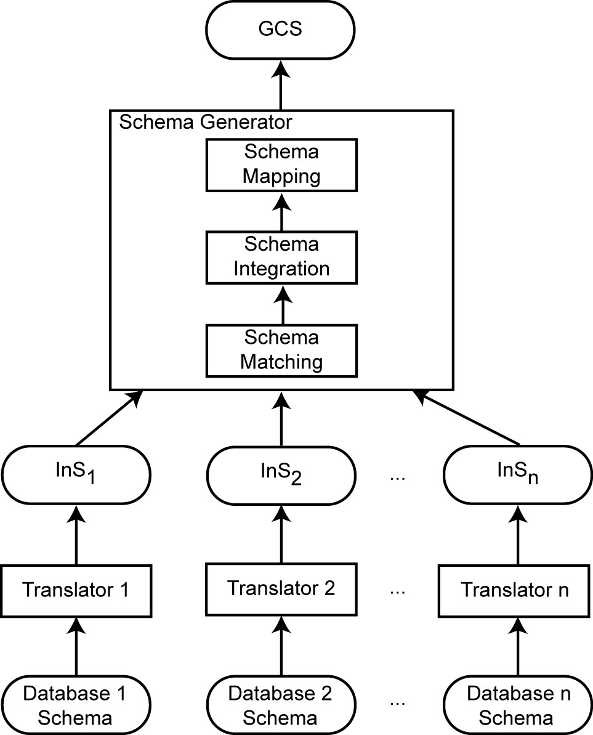
Database Integration Process

Slide 8
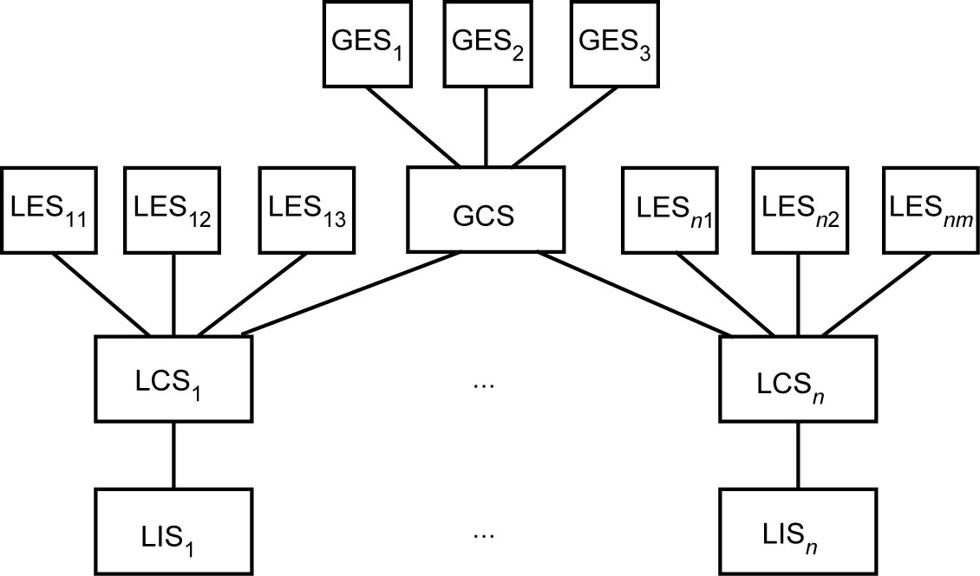
Recall Access Architecture

Slide 9
Database Integration Issues
Schema translation
Component database schemas translated to a common intermediate canonical representation
Schema generation
Intermediate schemas are used to create a global conceptual schema

Slide 10
Schema Translation
What is the canonical data model?
Relational
Entity-relationship
DIKE
Object-oriented
ARTEMIS
Graph-oriented
DIPE, TranScm, COMA, Cupid
Preferable with emergence of XML
No common graph formalism
Mapping algorithms
These are well-known

Slide 11
Schema Generation
Schema matching
Finding the correspondences between multiple schemas
Schema integration
Creation of the GCS (or mediated schema) using the correspondences
Schema mapping
How to map data from local databases to the GCS
Important: sometimes the GCS is defined first and schema matching and schema mapping is done against this target GCS

Slide 12
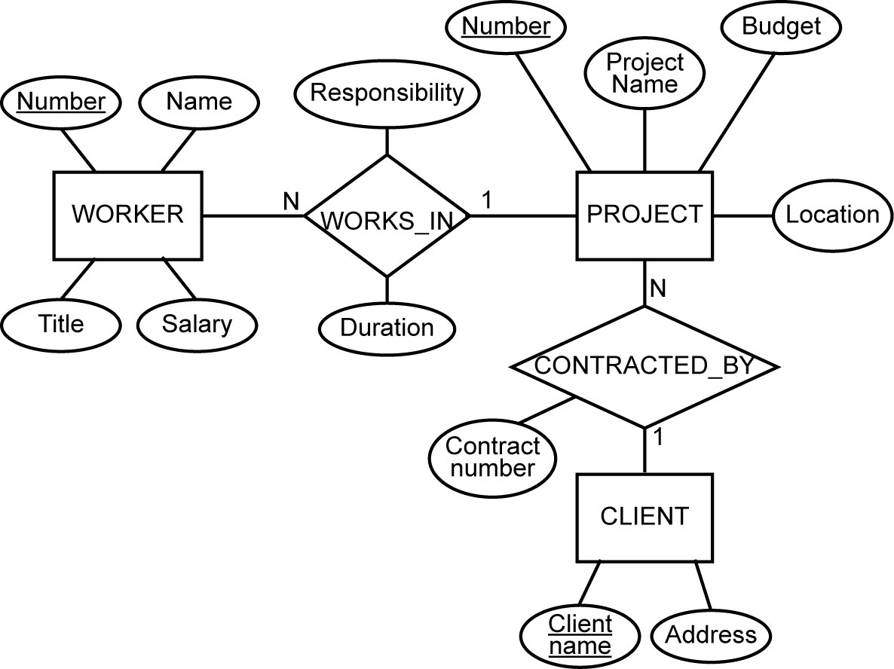
Running Example
E-R Model
Relational
EMP(ENO, ENAME, TITLE)
PROJ(PNO, PNAME, BUDGET, LOC, CNAME)
ASG(ENO, PNO, RESP, DUR)
PAY(TITLE, SAL)

Slide 13
Schema Matching
Schema heterogeneity
Structural heterogeneity
Type conflicts
Dependency conflicts
Key conflicts
Behavioral conflicts
Semantic heterogeneity
More important and harder to deal with
Synonyms, homonyms, hypernyms
Different ontology
Imprecise wording

Slide 14
Schema Matching (cont’d)
Other complications
Insufficient schema and instance information
Unavailability of schema documentation
Subjectivity of matching
Issues that affect schema matching
Schema versus instance matching
Element versus structure level matching
Matching cardinality

Slide 15
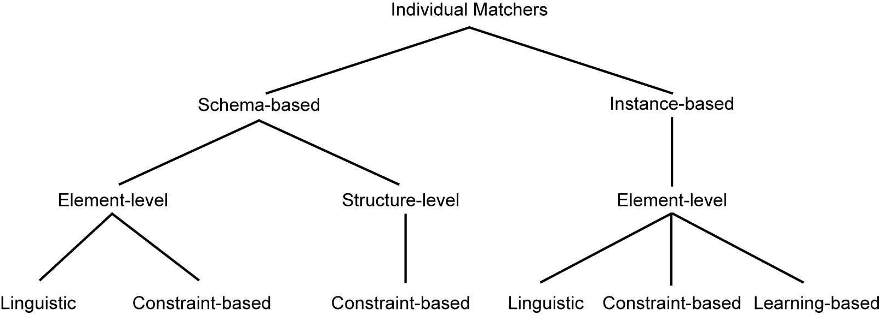
Schema Matching Approaches

Slide 16
Linguistic Schema Matching
Use element names and other textual information (textual descriptions, annotations)
May use external sources (e.g., Thesauri)
〈SC1.element-1 ≈ SC2.element-2, p,s〉
Element-1 in schema SC1 is similar to element-2 in schema SC2 if predicate p holds with a similarity value of s
Schema level
Deal with names of schema elements
Handle cases such as synonyms, homonyms, hypernyms, data type similarities
Instance level
Focus on information retrieval techniques (e.g., word frequencies, key terms)
“Deduce” similarities from these

Slide 17
Linguistic Matchers
Use a set of linguistic (terminological) rules
Basic rules can be hand-crafted or may be discovered from outside sources (e.g., WordNet)
Predicate p and similarity value s
hand-crafted ⇒ specified,
discovered ⇒ may be computed or specified by an expert after discovery
Examples
〈uppercase names ≈ lower case names, true, 1.0〉
〈uppercase names ≈ capitalized names, true, 1.0〉
〈capitalized names ≈ lower case names, true, 1.0〉
〈DB1.ASG ≈ DB2.WORKS_IN, true, 0.8〉

Slide 18
Automatic Discovery of Name Similarities
Affixes
Common prefixes and suffixes between two element name strings
N-grams
Comparing how many substrings of length n are common between the two name strings
Edit distance
Number of character modifications (additions, deletions, insertions) that needs to be performed to convert one string into the other
Soundex code
Phonetic similarity between names based on their soundex codes
Also look at data types
Data type similarity may suggest stronger relationship than the computed similarity using these methods or to differentiate between multiple strings with same value

Slide 19
N-gram Example
3-grams of string “Responsibility” are the following:
Res  sib
ibi  esp
bip  spo
ili  pon
lit  ons
ity  nsi
3-grams of string “Resp” are
Res
esp
3-gram similarity: 2/12 = 0.17

Slide 20
Edit Distance Example
Again consider “Responsibility” and “Resp”
To convert “Responsibility” to “Resp”
Delete characters “o”, “n”, “s”, “i”, “b”, “i”, “l”, “i”, “t”, “y”
To convert “Resp” to “Responsibility”
Add characters “o”, “n”, “s”, “i”, “b”, “i”, “l”, “i”, “t”, “y”
The number of edit operations required is 10
Similarity is 1 − (10/14) = 0.29

Slide 21
Constraint-based Matchers
Data always have constraints – use them
Data type information
Value ranges
…
Examples
RESP and RESPONSIBILITY: n-gram similarity = 0.17, edit distance similarity = 0.19 (low)
If they come from the same domain, this may increase their similarity value
ENO in relational, WORKER.NUMBER and PROJECT.NUMBER in E-R
ENO and WORKER.NUMBER may have type INTEGER while PROJECT.NUMBER may have STRING

Slide 22
Constraint-based Structural Matching
If two schema elements are structurally similar, then there is a higher likelihood that they represent the same concept
Structural similarity:
Same properties (attributes)
“Neighborhood” similarity
Using graph representation
The set of nodes that can be reached within a particular path length from a node are the neighbors of that node
If two concepts (nodes) have similar set of neighbors, they are likely to represent the same concept

Slide 23
Learning-based Schema Matching
Use machine learning techniques to determine schema matches
Classification problem: classify concepts from various schemas into classes according to their similarity. Those that fall into the same class represent similar concepts
Similarity is defined according to features of data instances
Classification is “learned” from a training set

Slide 24
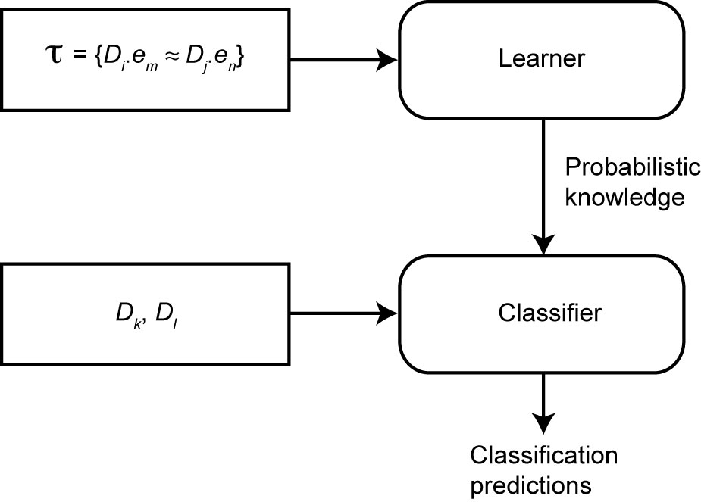
Learning-based Schema Matching

Slide 25
Combined Schema Matching Approaches
Use multiple matchers
Each matcher focuses on one area (name, etc)
Meta-matcher integrates these into one prediction
Integration may be simple (take average of similarity values) or more complex (see Fagin’s work)

Slide 26
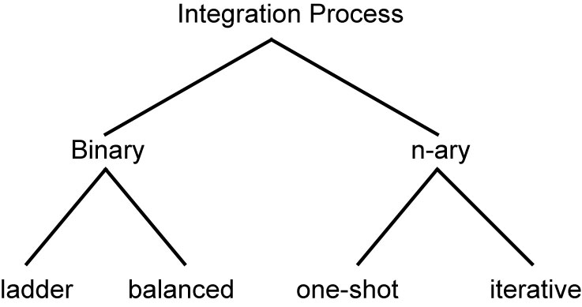
Schema Integration
Use the correspondences to create a GCS
Mainly a manual process, although rules can help

Slide 27
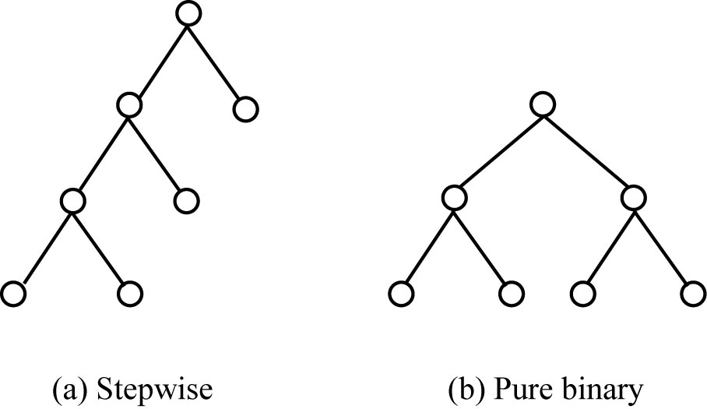
Binary Integration Methods

Slide 28
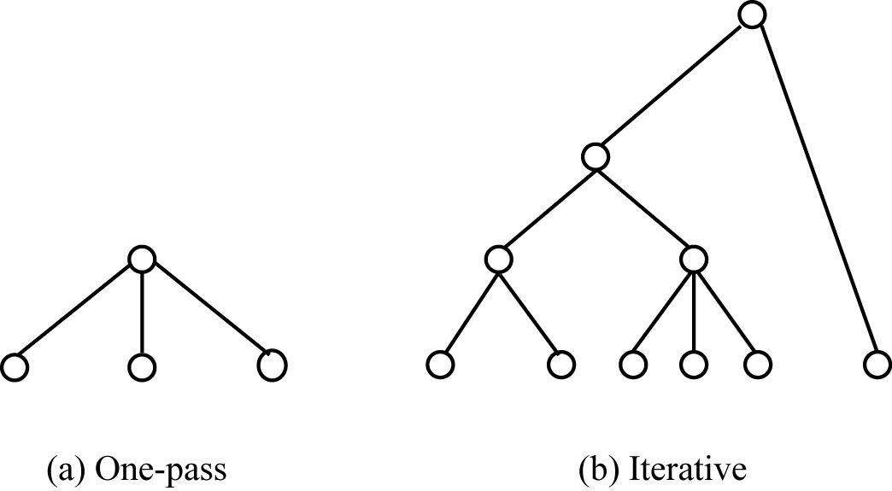
N-ary Integration Methods

Slide 29
Schema Mapping
Mapping data from each local database (source) to GCS (target) while preserving semantic consistency as defined in both source and target.
Data warehouses ⇒ actual translation
Data integration systems ⇒ discover mappings that can be used in the query processing phase
Mapping creation
Mapping maintenance

Slide 30
Mapping Creation
Given
A source LCS
A target GCS
A set of value correspondences discovered during schema matching phase
Produce a set of queries that, when executed, will create GCS data instances from the source data.
We are looking, for each T_{k}, a query Q_{k} that is defined on a (possibly proper) subset of the relations in S such that, when executed, will generate data for T_{i} from the source relations

Slide 31
Mapping Creation Algorithm
General idea:
Consider each T_{k} in turn. Divide V_{k} into subsets such that each specifies one possible way that values of T_{k} can be computed.
Each can be mapped to a query that, when executed, would generate some of T_{k}’s data.
Union of these queries gives

